Slide 1

Introduction to D3

Slide 2
D3’s data model
visual form
data
selection

Slide 3
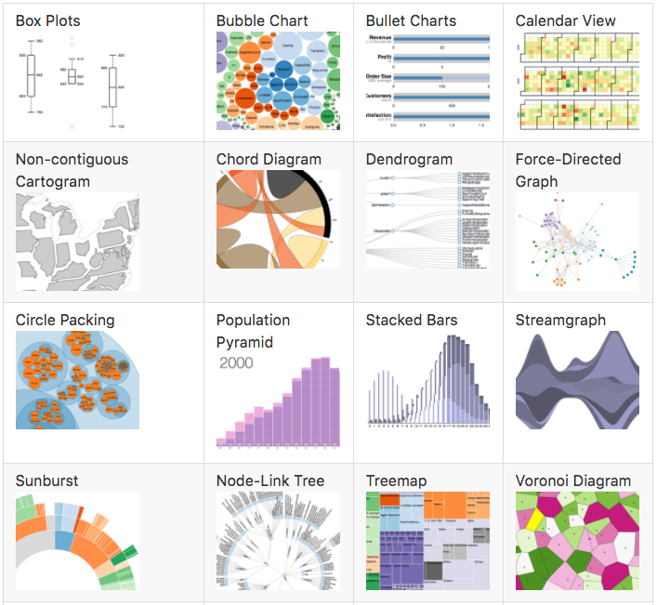
What can D3 build

Slide 4
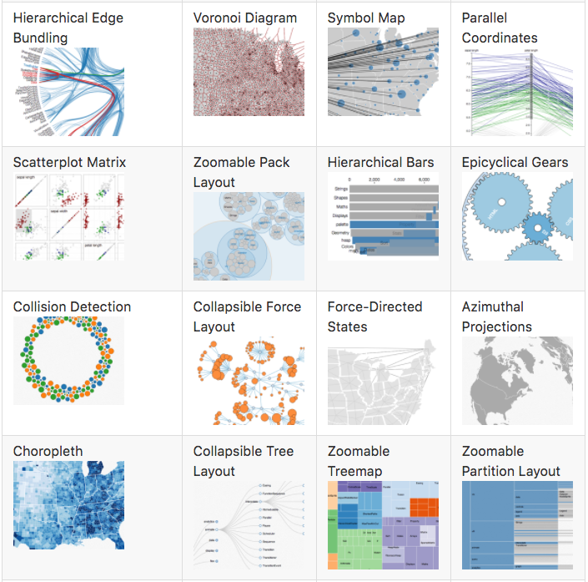
What can D3 build

Slide 5
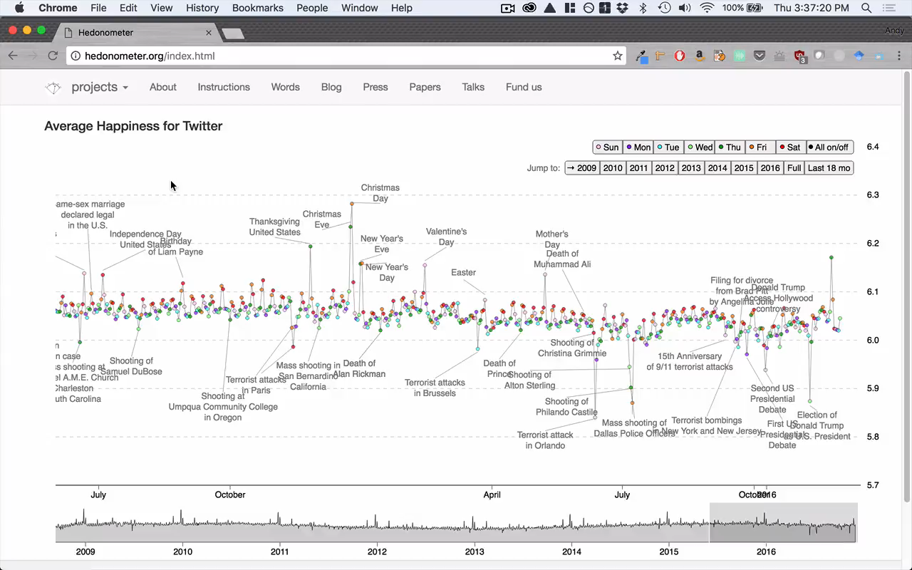

Slide 6
D3 technologies
HTML
CSS
JS
SVG
The DOM

Slide 7
Web programming 101
Client
(Google Chrome)
Web server
(python –m http.server)

Slide 8
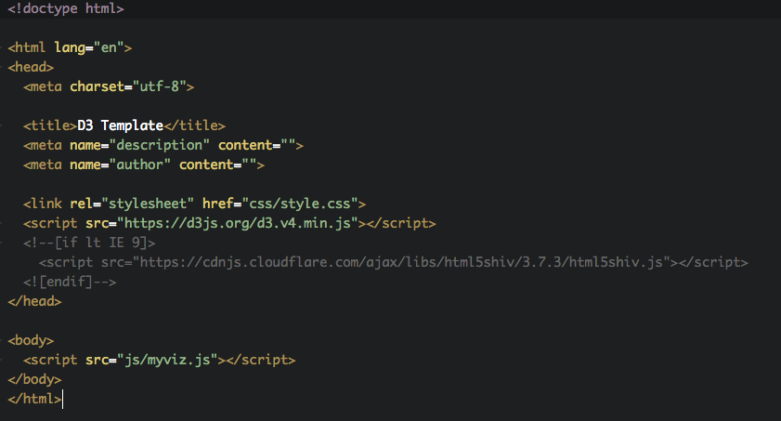
Getting started

Slide 9
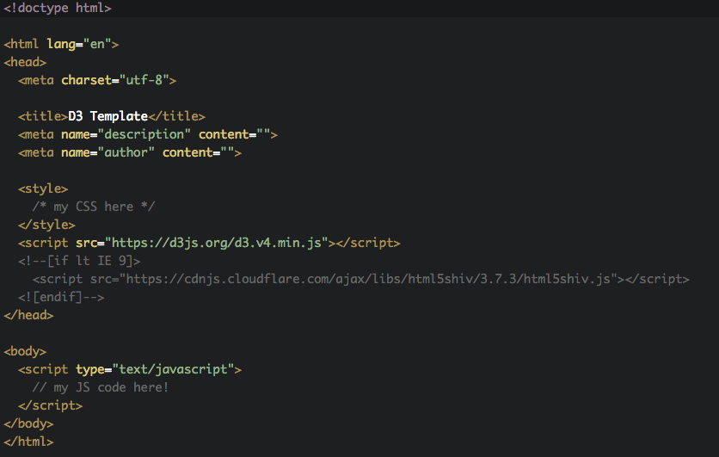
Getting started

Slide 10
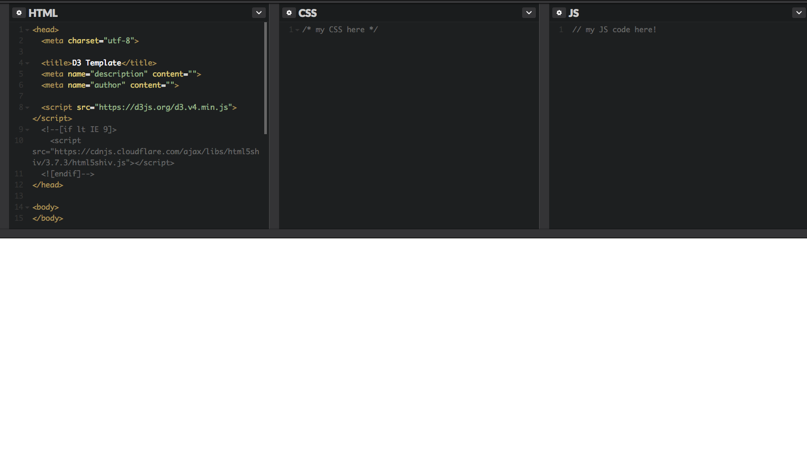
How this works in CodePen

Slide 11
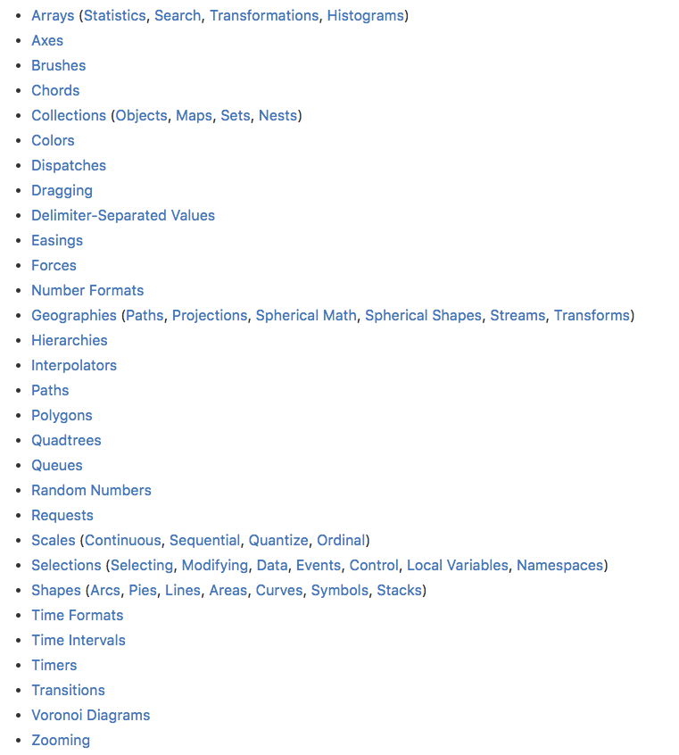
D3 version 4
D3 is made up of
many, small modules
From the D3 API Ref:
https://github.com/d3/d3/blob/master/API.md

Slide 12


